Slide 1


Test Automation Using Selenium
Fair Hike Academy
That’s the way the cookie crumbles!
Session 3: Selenium Introduction
Mentor : Naresh Vulli, CSTE, PAHM.
fairhike@gmail.com www.fairhike.blogspot.com | www.facebook.com/fairhike

Slide 2
Today’s Topics
Recap
Selenium Tool Overview
Selenium Tool Suite
Selenium IDE
Installation
Selenium IDE icons
Record & Run a Simple Test
Export Test
Takeaways or Exercise

Slide 3
Selenium Tool Overview
Selenium is an open source tool for web application testing. This tool is primarily developed in Java Script and browser technologies and hence supports all the major browsers on all the platforms.
In terms of coverage for platform and browser, Selenium is probably one of the best tool available in the market for web applications.

Slide 4
Selenium Tool Suite
Selenium IDE
Selenium RC (aka. Selenium 1 or Remote Control)
Selenium WebDriver (aka. Selenium 2)
Selenium-Grid

Slide 5
Selenium IDE
Selenium IDE is an integrated development environment for performing Selenium tests.
Selenium tests can be written as HTML tables or coded in various languages like C#, PHP, Perl, Python and can be run directly in most modern browsers
The IDE can help you to record, edit and debug tests. Currently the IDE is only available for Firefox as a add-on.

Slide 6
Installation
https://addons.mozilla.org/en-US/firefox/addon/selenium-ide/
Download the Plugin
Choose “Install now” option
Restart the browser
Tools → Selenium IDE

Slide 7
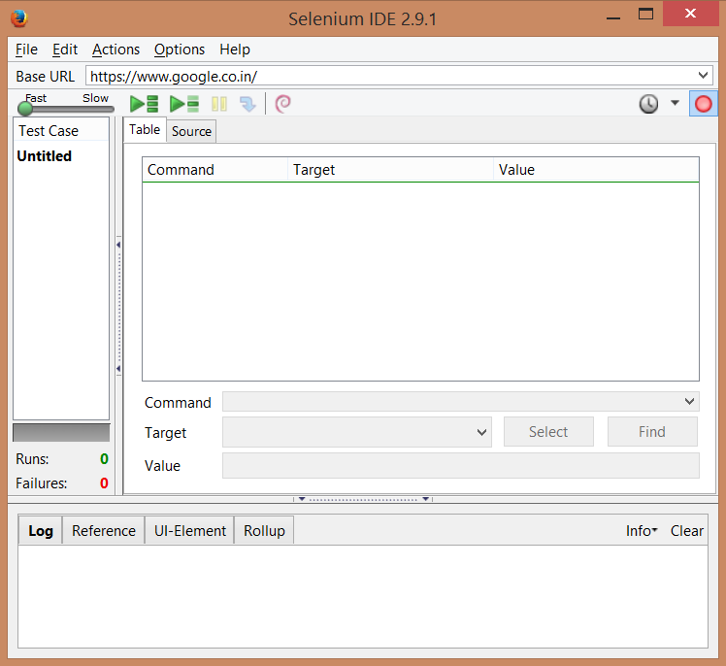
Selenium IDE icons
http://www.seleniumhq.org/docs/02_selenium_ide.jsp#

Slide 8
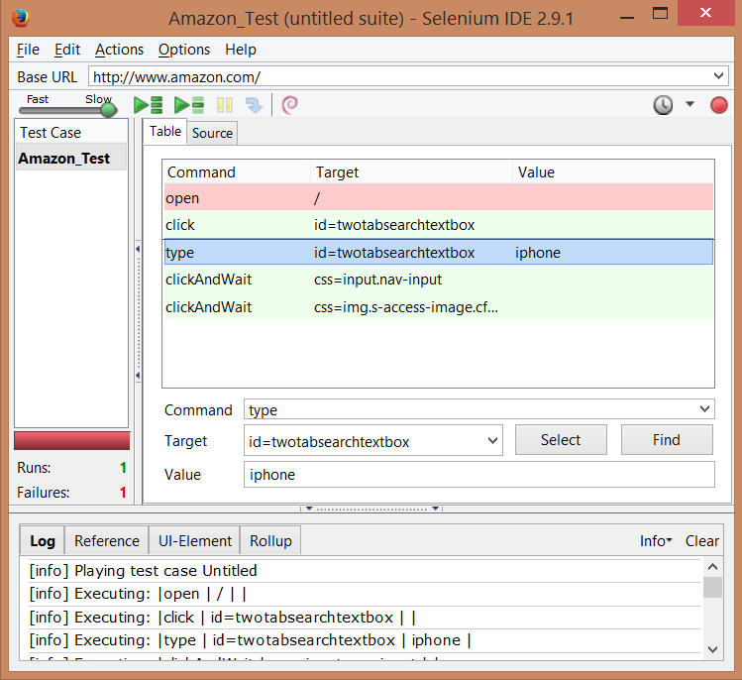
Record & Run a simple test

Slide 9
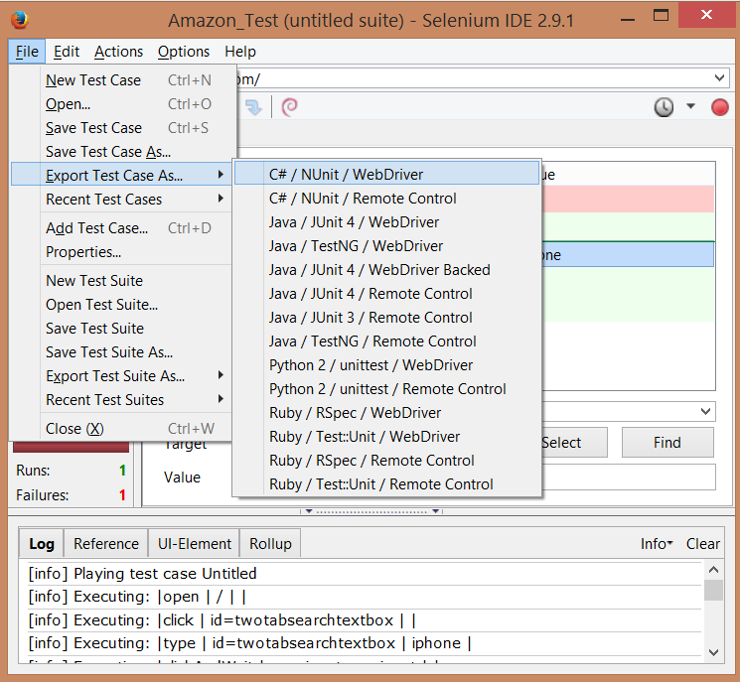
Export Test

Slide 10
Takeaway or Exercise
Record and Run a scenario
Export test case and analyze code

Slide 11
Q & A

Slide 12
Thank You ☺

